Slide 1
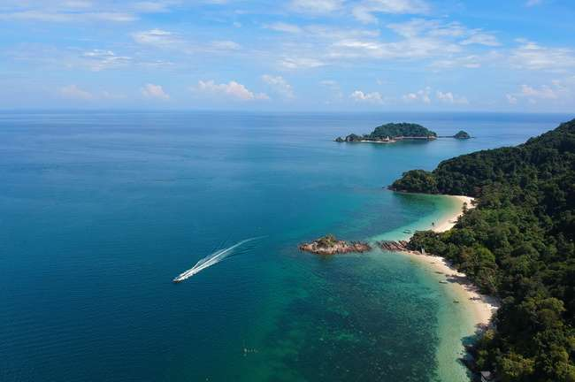
Home
About Us
Contact
Search...
TOURISM
Preferences
DATA MINDS
MUNAVARA ID12214686
URIEL PACHECO ID 1225009
ALIKHANOVA ZEINEP ID12244669
KONNO MALIK ADAMS ID 12250035

Slide 2
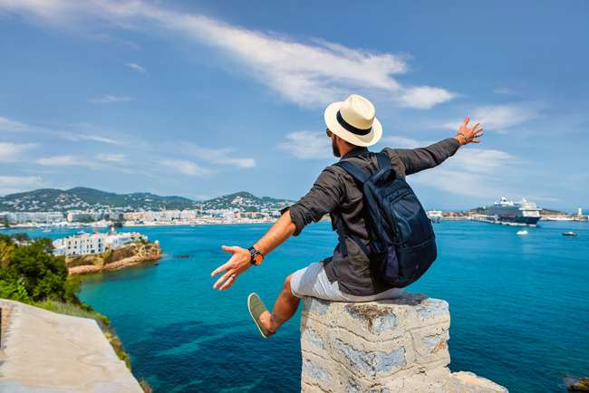
Data Minds
Search...
Analyzing Tourism Preferences and Behaviors Using AI-Based Tools
What problem are we solving?
Information overload
Diverse preferences
Rapidly changing trends
Read More
Aim: Support smarter decision -making using AI

Slide 3
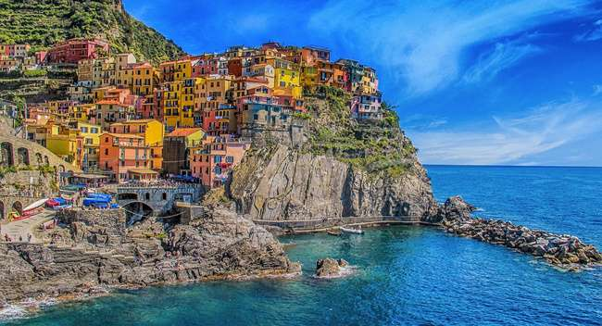
Data Minds
Search...
Why
This Topic Matters
Economically and socially important
How data-driven decisions can improve travel services and user experiences
Post -COVID changes in travel behaviors

Slide 4
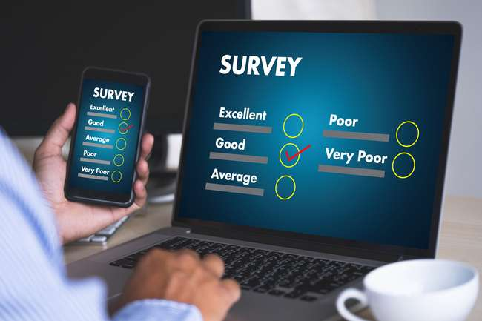
Data Minds
Search...
Project objectives
Analyze travel behaviors and preferences
Use survey data+AI models like GPT
Provide recommendations for the tourism sector

Slide 5
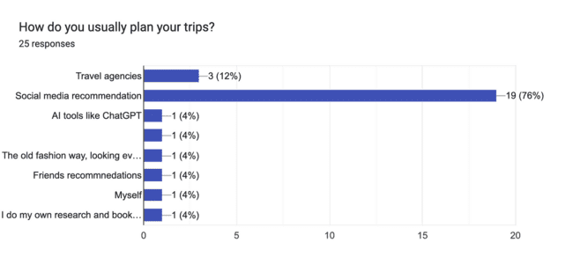
Survey results
Number of participants : 25
Target audience: Students, working professionals
Link: https://forms.gle/GCcSpm7NrRG7XJwd6

Slide 6
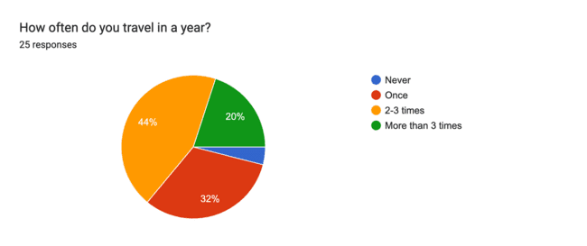
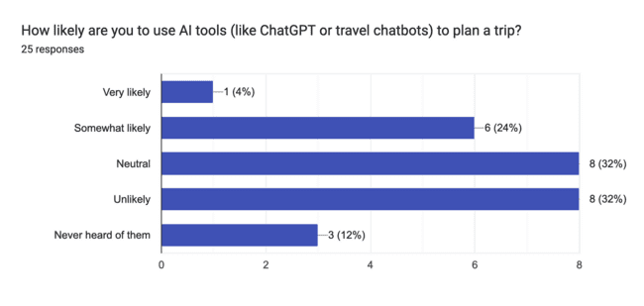
Survey results
Main purpose of traveling: Leisure /Vacation
68% of responders were female
Age group between 18-24

Slide 7
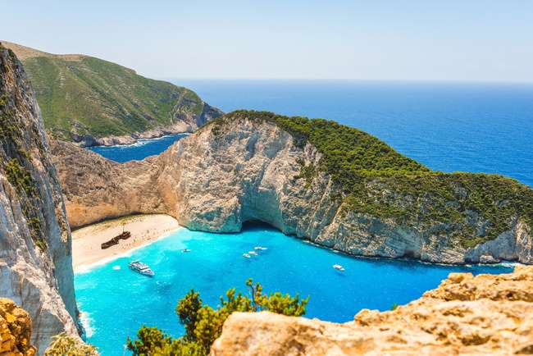

Data Minds
Search...
What we seek to find with this analysis?
With this analysis, we aim to understand the behavioral patterns of tourists, identify peak seasons, and evaluate the economic and social impact of tourism in selected regions.

Slide 8
Data Minds
Search...
Tourism Research
How will we achieve it?
To achieve this goal, we will use GPT tools in combination with data analysis using Python and cluster models.
These will be just some of the libraries we can use for our analysis.
scikit-learn
TensorFlow
pandas
Keras

Slide 9
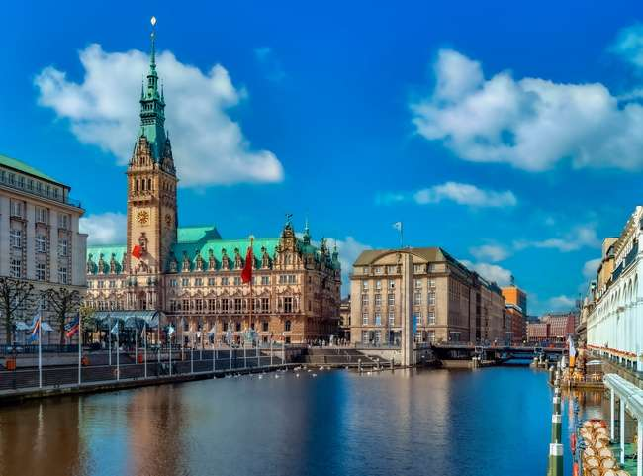
Data Minds
Search...
Travel Presentation
Insights
AI Delivers
“With these tools, we get powerful insights. We can group tourists by interests—say, culture lovers vs. adventure seekers. We see when they book, how long they stay, how much they spend, and even what annoys or delights them. That’s gold for marketing and planning.”

Slide 10

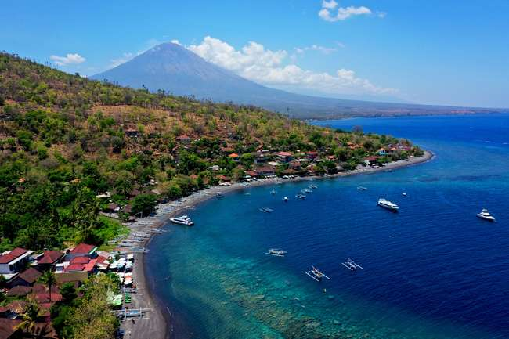
Data Minds
Search...
Real Uses & Challenges
Smart Uses – And Smart Caution
Cities like Singapore and Barcelona are already using AI for crowd management and planning. Travel apps use it for better recommendations. But we’ve got to be careful: privacy is a big concern, and biased algorithms can lead to bad decisions. So, while AI is powerful, human oversight is still key.

Slide 11

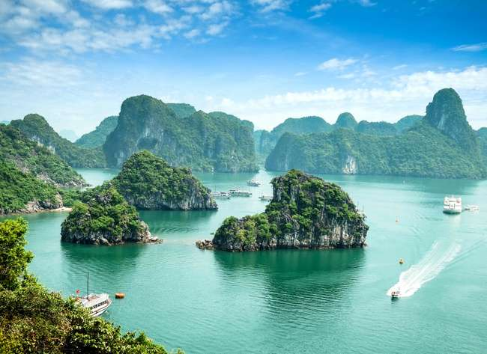
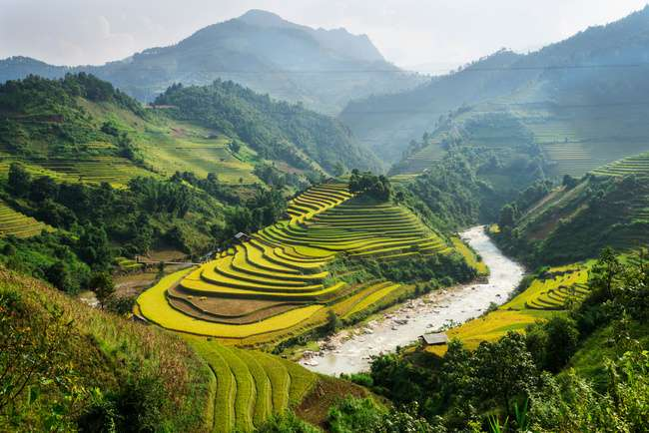
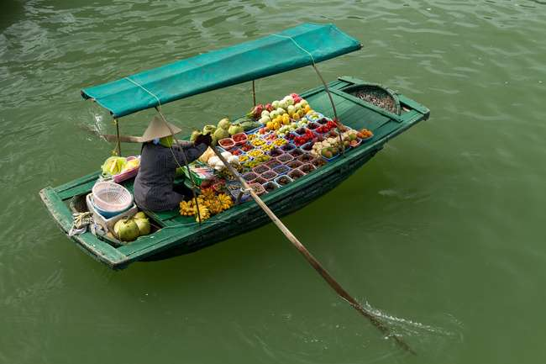

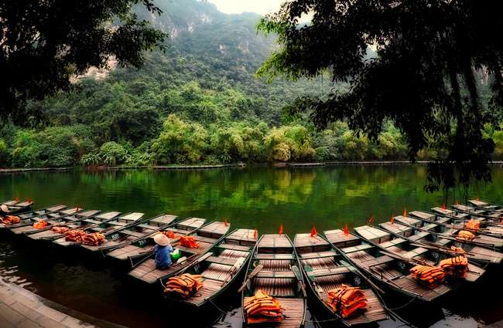
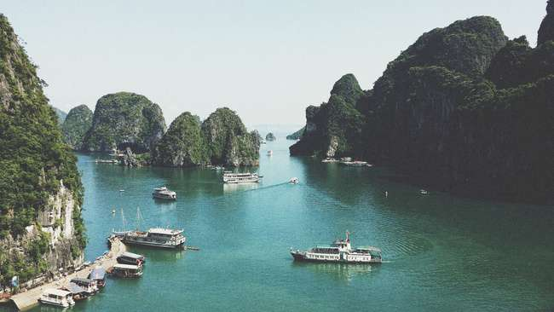
TRAVEL HIGHLIGHT
Real Uses & Challenges
✅ Applications
Personalized travel offers
Smart city planning for tourism (e.g., crowd management)
Real-time service adjustment based on behavior
Sustainable tourism monitoring and reporting
Data privacy concerns (e.g., GDPR compliance)
Algorithm bias affecting decision-making
Complex AI models hard to interpret
Integration issues across diverse data sources

Slide 12
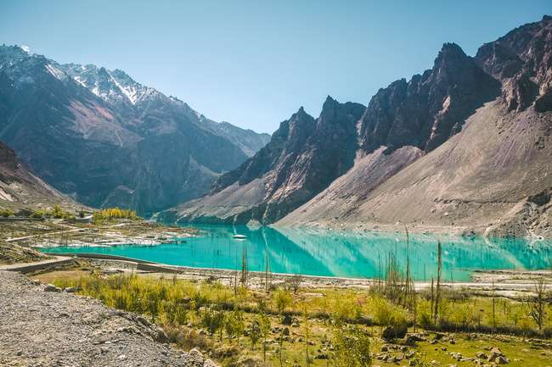

Global AI in Tourism: Key Statistics
76%
52%
320 M+
280 M+
OF TRAVELERS SAY PERSONALIZED EXPERIENCES ARE MORE LIKELY TO MAKE THEM BOOK AGAIN
BOOKINGS ARE NOW INFLUENCED BY AI-POWERED RECOMMENDATION ENGINES
OF TRAVEL COMPANIES ARE ALREADY USING AI FOR CUSTOMER SERVICE OR MARKETING
MILLENNIALS PREFER BOOKING TRIPS BASED ON SOCIAL MEDIA INSPIRATION

Slide 13
Expected Outcomes
Clarification of travel trends among young adults (18-24 years old)
- Main purpose is “leisure” and “visiting friends and relatives”; travel is mainly by air; lodging is mainly by Airbnb and hotels.
Identification of travel decision factors
- “Cost”, “natural environment” and “cultural attractions” are the main selection factors. Strong correlation between frequency of travel and budget.
Identification of potential use of AI tools
- Many plan trips based on “SNS recommendations”. Interest in “AI tools such as GPT” was neutral to slightly positive, with room for implementation.
Organize travel promotion and barrier factors
- Factors hindering travel are “cost,” “lack of reliable information,” and “visas and safety.”
- Inexpensive options, flexible schedules, and planning support tools are effective in promoting travel.
Providing a foundation for considering the impact of tourism on the region
- Identifying tourism needs and challenges provides evidence for recommendations for tourism policy and economic development.

Slide 14
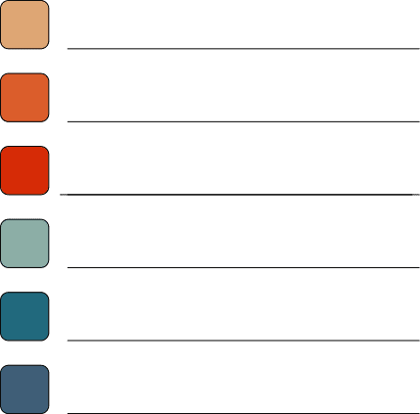

Questionnaire design and implementation (May 9)
Data collection and formatting (May 9)
Analysis using GPT, etc. (May 10)
Creation of graphs, etc. using visualization tools (May 11)
Prepare report and PPT (May 11- May 22)
Final presentation 5/23
Flow chart

Slide 15
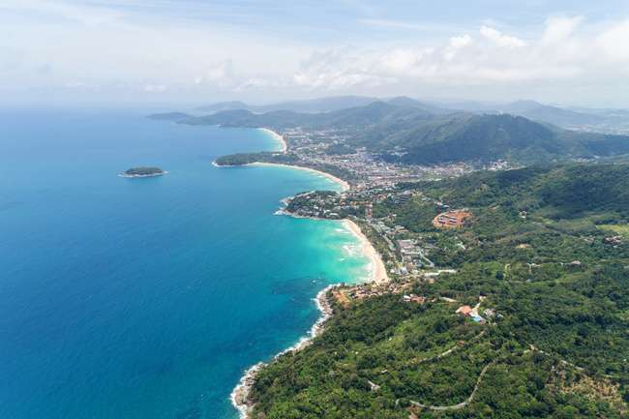

Data Minds
Search...
Thank you !

